Slide 1
Unit 5- Lecture 33
Network structures
Perceptron

Slide 2
Network structures
There are a variety of kinds of network structure, each of which results in very different computational properties.
The main distinction to be made is between feed-forward and recurrent networks.
In a feed-forward network, links are unidirectional, and there are no cycles.
In a recurrent network, the links can form arbitrary topologies.
Technically speaking, a feed-forward network is a directed acyclic graph (DAG).
In a layered feed-forward network, each unit is linked only to units in the next layer; there are no links between units in the same layer, no links backward to a previous layer, and no links that skip a layer.

Slide 3
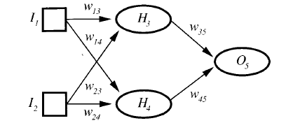
Figure shows a very simple example of a layered feed-forward network.
This network has two layers; because the input units (square nodes) simply serve to pass activation to the next layer, they are not counted.

Slide 4
A feed-forward network simply computes a function of the input values that depends on the weight settings—it has no internal state other than the weights themselves.
Some regions of the brain are largely feed-forward and somewhat layered, but there are rampant back-connections.
In our terminology, the brain is a recurrent network.
Because activation is fed back to the units that caused it, recurrent networks have internal state stored in the activation levels of the units.
Recurrent networks can become unstable, or oscillate, or exhibit chaotic behavior.
Given some input values, it can take a long time to compute a stable output, and learning is made more difficult.

Slide 5
Examine figure in slide 3, which shows the topology of a very simple neural network.
On the left are the input units.
The activation value of each of these units is determined by the environment.
At the right-hand end of the network are output units.
In between, the nodes labelled H3 and H4 have no direct connection to the outside world.
These are called hidden units, because they cannot be directly observed by noting the input/output behavior of the network.
Some networks, called perceptrons, have no hidden units.

Slide 6

This makes the learning problem much simpler, but it means that perceptrons are very limited in what they can represent.
Networks with one or more layers of hidden units are called multilayer networks.
The network in slide 3 figure calculates the following function:
where g is the activation function, and ai is the output of node i.
Notice that because the activation functions g are nonlinear, the whole network represents a complex nonlinear function.
If you think of the weights as parameters or coefficients of this function, then learning just becomes a process of tuning the parameters to fit the data in the training set—a process that statisticians call nonlinear regression.

Slide 7
Perceptron
Layered feed-forward networks were first studied in the late 1950s under the name perceptrons.
Although networks of all sizes and topologies were considered, the only effective learning element at the time was for single-layered networks, so that is where most of the effort was spent.
Today, the name perceptron is used as a synonym for a single-layer, feed-forward network.
The left-hand side of Figure in next slide shows such a perceptron network.
Notice that each output unit is independent of the others — each weight only affects one of the outputs.

Slide 8
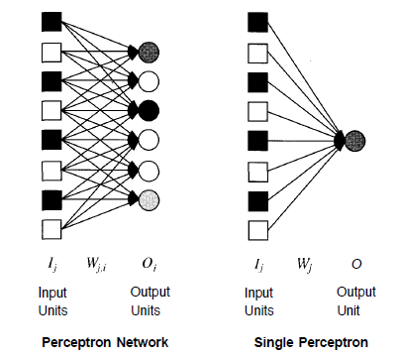

Slide 9
That means that we can limit our study to perceptrons with a single output unit, as in the right-hand side of Figure in previous slide, and use several of them to build up a multi-output perceptron.
What perceptron can represent
Units can represent the simple Boolean functions AND, OR, and NOT, and that therefore a feed-forward network of units can represent any Boolean function, if we allow for enough layers and units.
But what Boolean functions can be represented with a single-layer perceptron?
Some complex Boolean functions can be represented.

Slide 10
Learning linearly separable functions
A function can be represented by a perceptron if and only if it is linearly separable.
There is a perceptron algorithm that will learn any linearly separable function, given enough training examples.
Most neural network learning algorithms, including the perceptron learning method, follow the current-best-hypothesis (CBH) scheme.
The initial network has randomly assigned weights, usually from the range [-0.5,0.5].
The network is then updated to try to make it consistent with the examples.
This is done by making small adjustments in the weights to reduce the difference between the observed and predicted values.

Slide 11
The main difference from the logical algorithms is the need to repeat the update phase several times for each example in order to achieve convergence.
Typically, the updating process is divided into epochs.
Each epoch involves updating all the weights for all the examples.
The general scheme is shown as NEURAL-NETWORK-LEARNING in Figure in next slide.
For perceptrons, the weight update rule is particularly simple.
If the predicted output for the single output unit is O, and the correct output should be T, then the error is given by
Err = T - O

Slide 12
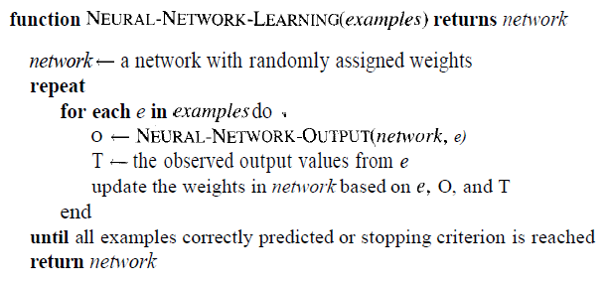

Slide 13

If the error is positive, then we need to increase O; if it is negative, we need to decrease 0.
we can achieve the effect we want with the following rule:
where the term a is a constant called the learning rate.
This rule is a slight variant of the perceptron learning rule proposed by Frank Rosenblatt in 1960.

